Slide 1
Project and App review

Slide 2

Static website

Slide 3
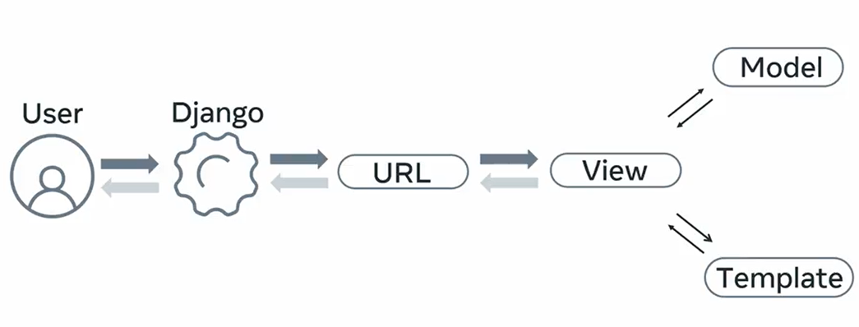

Slide 4


Slide 5
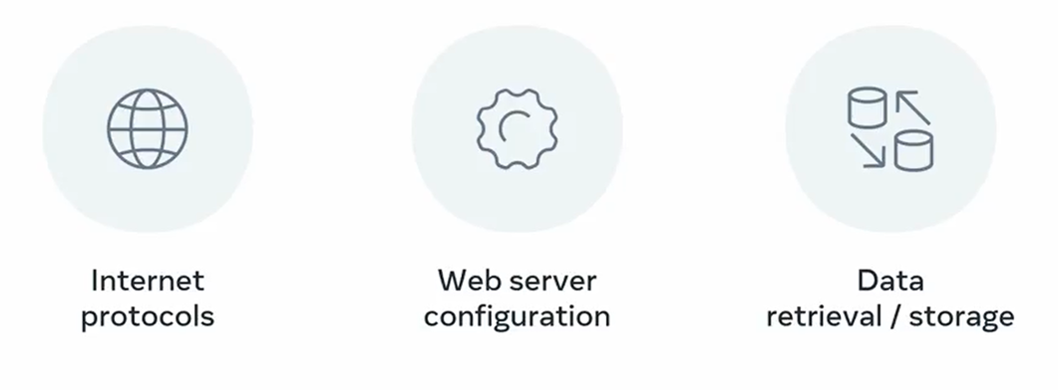

Slide 6
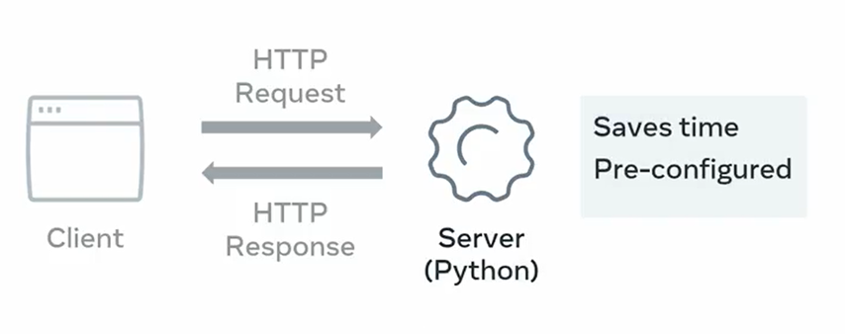
Development Server

Slide 7

Stateless

Slide 8
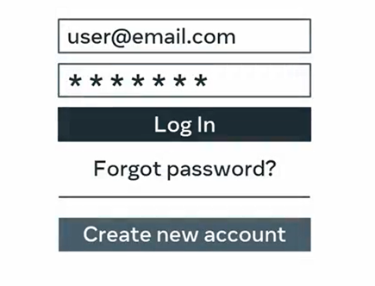

Slide 9

Django project

Slide 10
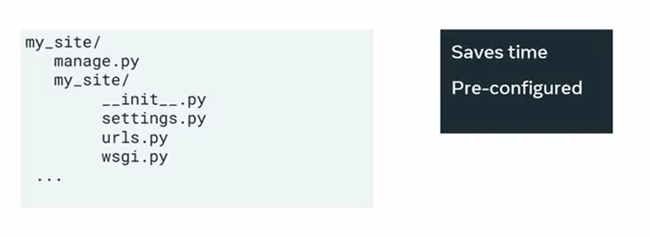
Django project

Slide 11
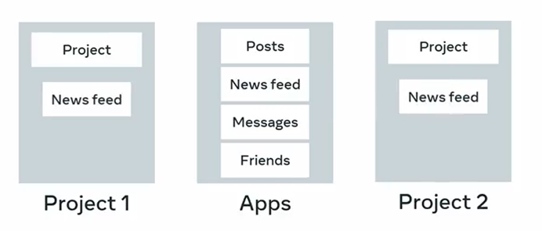
Django Application

Slide 12
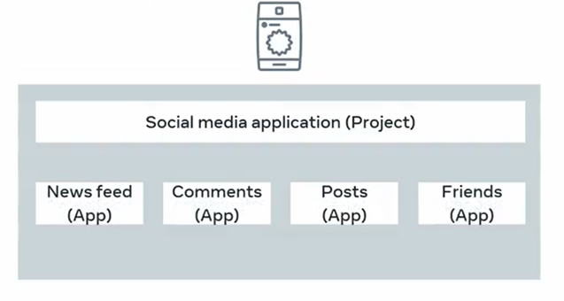
Django web application

Slide 13

Adding apps

Slide 14
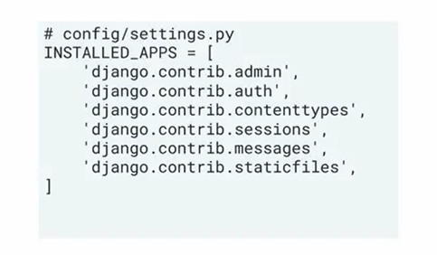
INSTALLED_APPS setting

Slide 15
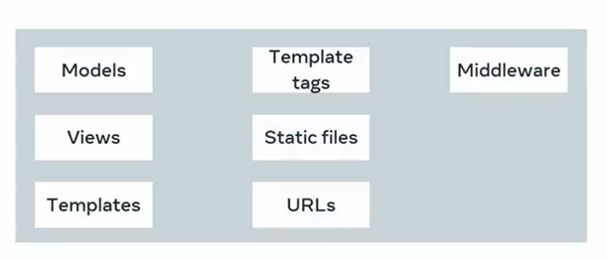
Django application

Slide 16


Slide 17
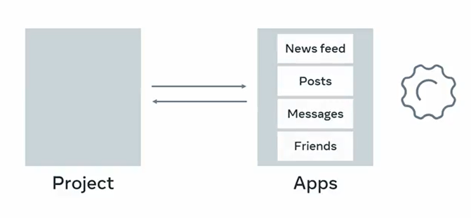
Django application

